Slide 1
Using Concept Formal Analysis for Cooperative
Information Retrieval
Ibtissem Nafkha, Samir Elloumi, and Ali Jaoua

Slide 2
Main Idea
In this paper, we will focus on the unique features of FCA for searching in distributed information and for reducing the size of the set information.
The development of a FCA-based applications for distributed information returns a major gain and the obtained results are promising.

Slide 3
Introduction
Collaborative( or cooperative ) information retrieval
Search in distruted information
Data Reduction

Slide 4
Mathematical Foundations
Formal Context
Galois Connection
Formal Concept
Concept Lattice
Equivalence between an object and a subset of other objects

Slide 5
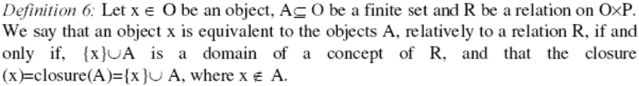
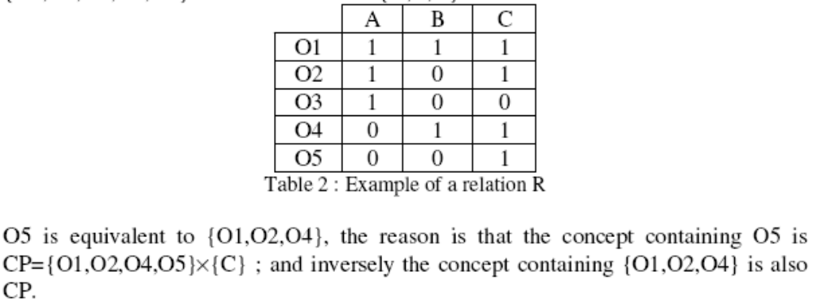
Equivalence between an object and a subset of other objects

Slide 6
Conceptual Reduction Method
Algorithm reduction (RD, R)
Initialize RD=R
For each object x in the domain of the remaining context RD, we do the following steps :
1) we find the set of its properties P (i.e. subset of attributes satisfied by x).
2) we find the set of objects S, except x, sharing all the properties P.
3) if S is not empty, we check if object x is included in the set of objects sharing the same properties as S. In the positive case, object x is removed from context RD.
End of the loop

Slide 7
Search enhanced by FCA
Cooperative Conceptual Information Retrieval System
Cooperative Conceptual Information Retrieval System based on Data Reduction
Conceptual Information Retrieval System based on Cooperative Conceptual Data Reduction

Slide 8
Cooperative Conceptual Information Retrieval System
Part 1: C2IRS uses a conceptual approach in the searching process from different databases. Each local result of each CIRS is a concept that we store in an Answer Array. We assume that we have N different formal contexts, so we can get a maximum of N concepts in the Answer Array.
Part 2: apply Merging Algorithm on the Answer Array in order to obtain the final answer.

Slide 9
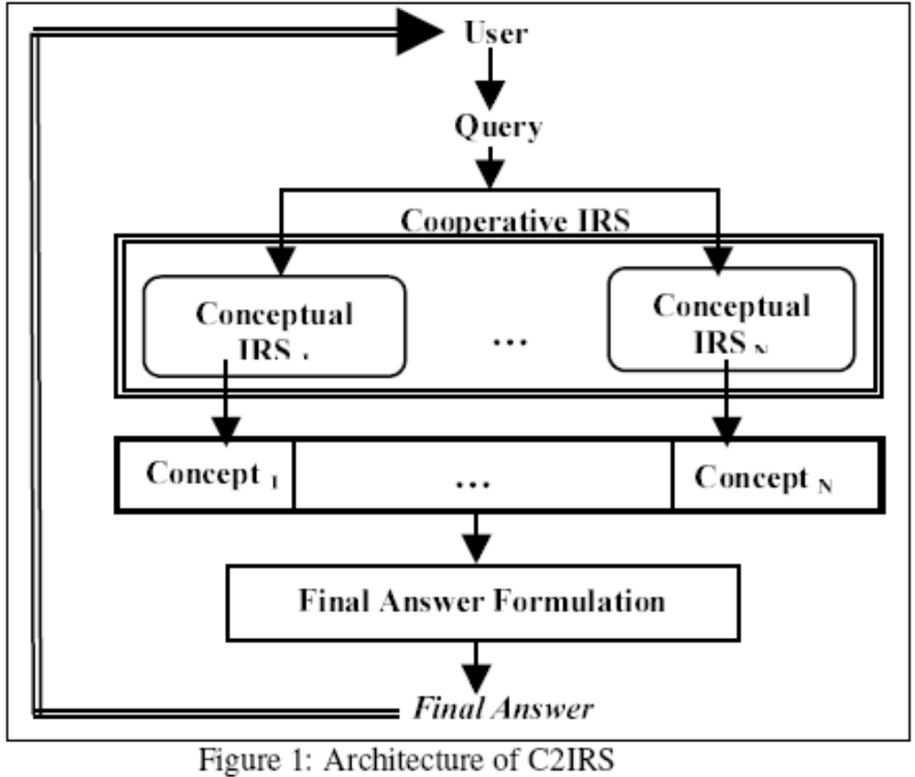
Cooperative Conceptual Information Retrieval System

Slide 10
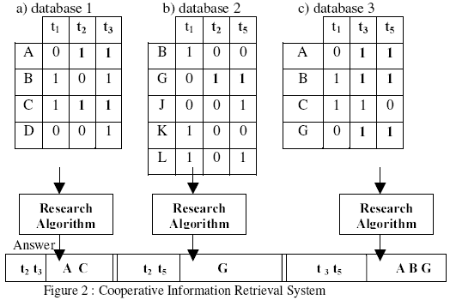
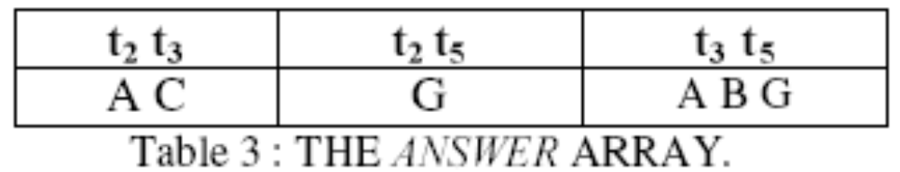

Slide 11
Cooperative Conceptual Information Retrieval System

Slide 12
Initially, the final answer is an the empty set. We read the set of concepts element by element. For each element, if the domain of a concept is equal or greater than the terms of the query, then we add its range (set of document references) to the final answer. If this condition is not satisfied, we build intersection between its range and ranges of other concepts in the answer array (i.e. a subset of documents), and we compute the union of the domains (to find a subset of terms). We continue to build these intersections until we find at least all the terms of the query.

Slide 13
Cooperative Conceptual Information Retrieval System based on Data Reduction
Part 1 : uses a conceptual approach, in the reducing process of different databases. Each database is reduced in order to minimize its size
and obtain a reduced database (RDB) and the equivalent objects set.
Part 2: Basing on the set of reduced databases (RDB) and the equivalent objects set, we cooperate to give a most complete answer to a query by using the cooperating process

Slide 14
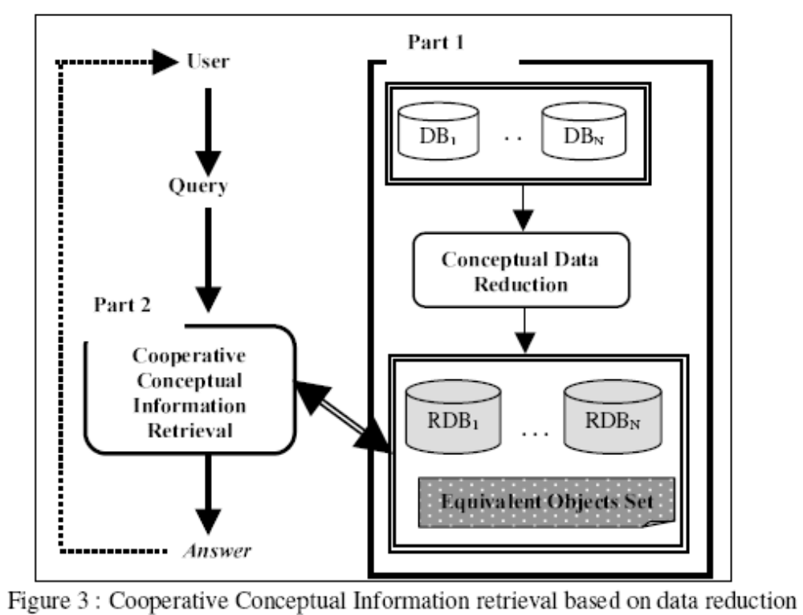

Slide 15
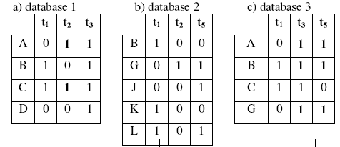
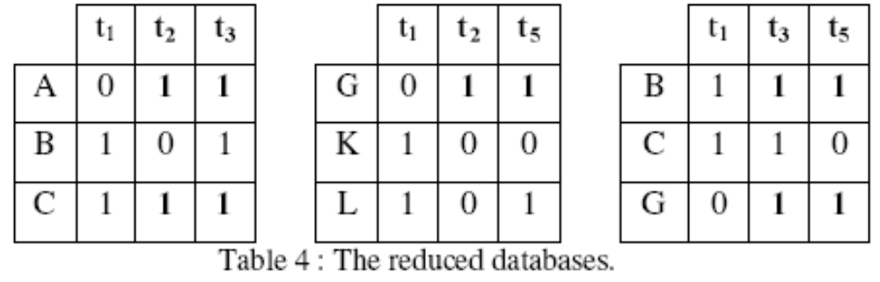
Conceptual Data Reduction
Assumes that we can minimize data without losing any knowledge. This algorithm is based on the elimination of any object that may be replaced by a subset of equivalent objects.

Slide 16
Conceptual Information Retrieval System based on Cooperative Conceptual Data Reduction
Part 1: From a set of formal contexts representing the databases, we apply the proposed algorithm for cooperative conceptual data reduction in order to obtain the reduced table and the set of equivalent objects.
Part 2: To respond to a query that is a set of terms, we apply the Galois connection to retrieve the documents satisfying the query. The final answer can be enriched by the set of equivalent objects.

Slide 17
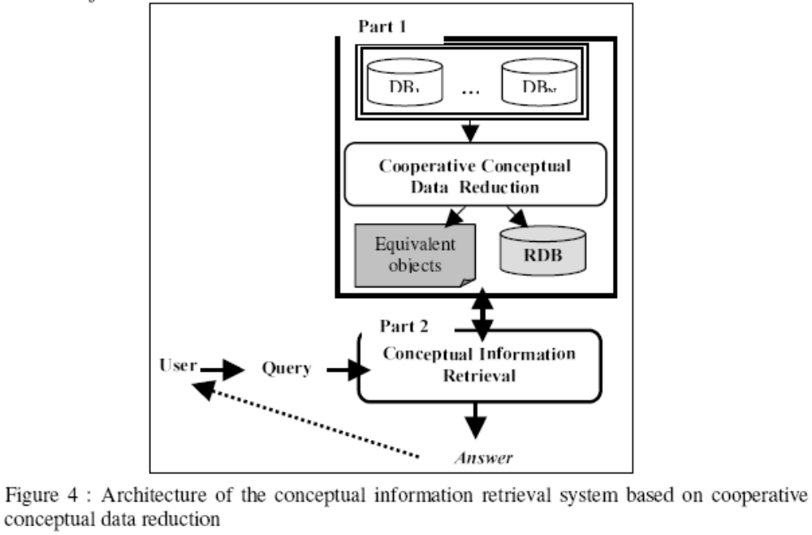

Slide 18
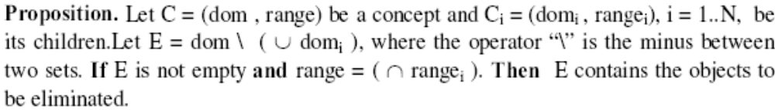
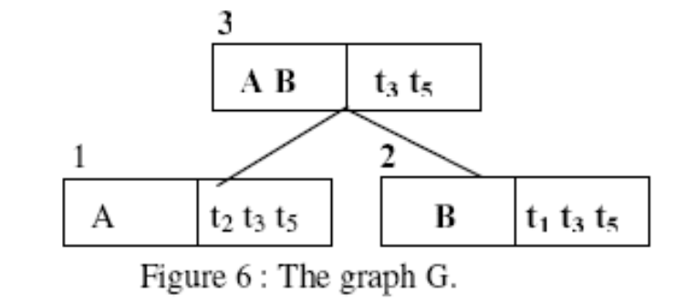

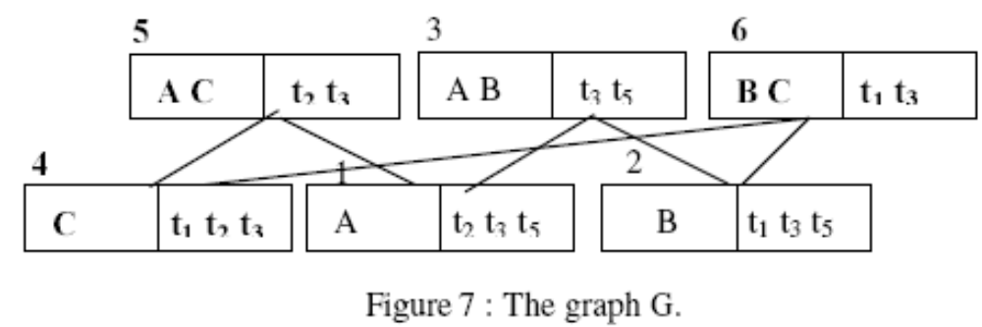
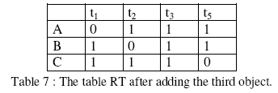
Cooperative conceptual data reduction

Slide 19
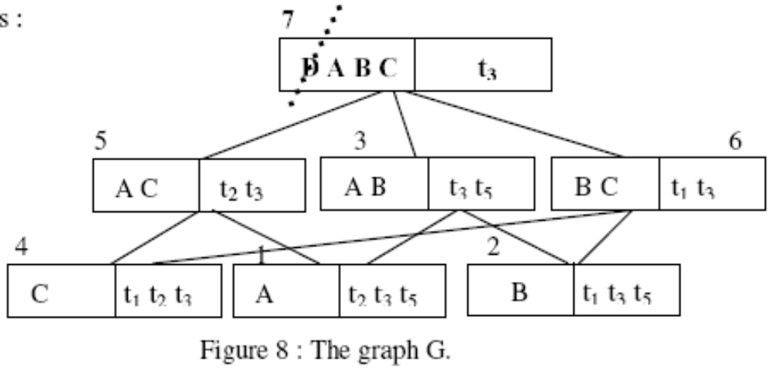
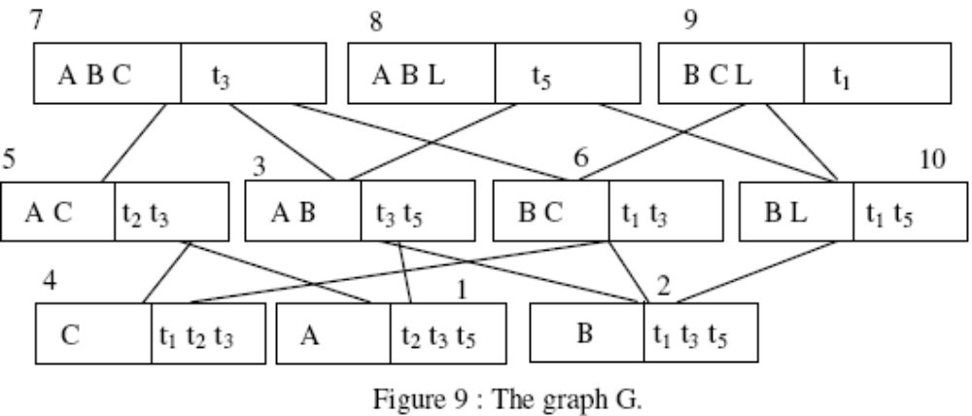
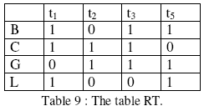

Slide 20
Conclusion
Integrate the data reduction in the search process
Search in the distributed information

Slide 21
Idea
针对其中的第二种方式，即就是在分布式的数据集上，对各自表进行查找，然后通过合并得到结果，其中在进行匹配是，本文使用的是精确的匹配，包括Equicalence object set的获得，可以采用近似的方式；
对于一个非常大的单个数据集，也可以采用先分后合的方式进行。

